Slide 1
A Large-Scale Epidemic Simulation Framework for Realistic Social Contact Networks
Loimos
Joy Kitson¹, Ian Costello¹, Diego Jiménez², Jiangzhuo Chen³, Jaemin Choi⁴, Stefan Hoops³, Esteban Meneses², Tamar Kellner¹, Henning Mortveit³, Jae-Seung Yeom⁵, Laxmikant V. Kale⁴, Madhav V. Marathe³, Abhinav Bhatele¹
¹University of Maryland
²National High Technology Center
³University of Virginia
⁴University of Illinois
⁵Lawrence Livermore National Laboratory

Slide 2
Motivation
We need to be ready for the next outbreak
Need to model a variety of intervention scenarios in a short period of time
We set out to design a scalable simulation to meet that need
Taken from [1].
Notes:
The rate at which new emerging infectious diseases (EIDs) appear is increasing

Slide 3
Overview
An infectious disease model needs to:
Simulate large populations
Handle flexible interventions
Account for uncertainty with large numbers of replicates
Do all the above while maintaining a quick turn-around time (~1 day)

Slide 4
Overview
Loimos…
Is an agent-based model
The behavior of each person is modeled directly
Operates on a people-location graph
People visit locations, where they can infect – or be infected by – other people
Interventions can directly modify those visits

Slide 5
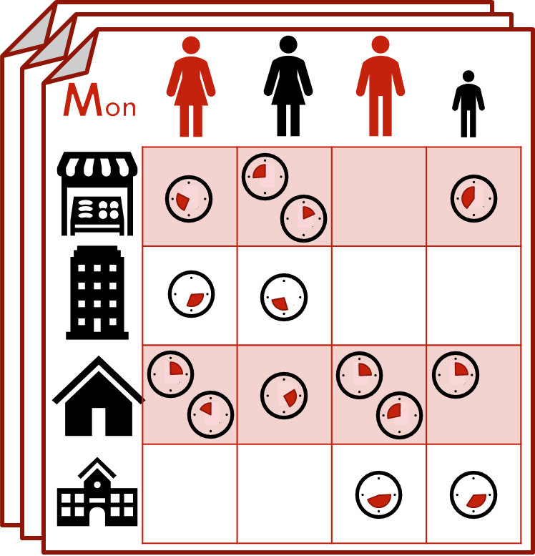
Modeling Infections
Each person has a daily visit schedule:
Repeats weekly
Specifies location, start and end times

Slide 6
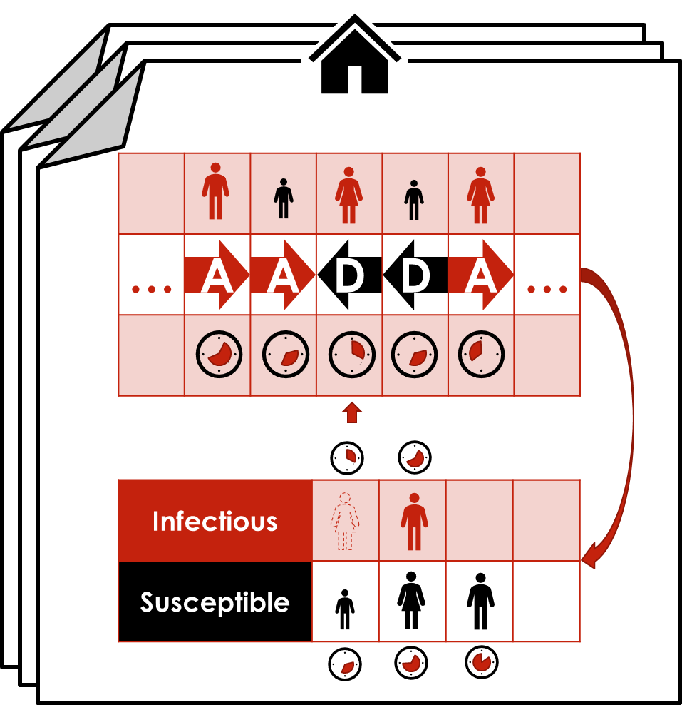
Modeling Infections
Each day, each location…
Receives a list of visits
Processes their arrivals and departures
Calculates the likelihood of infections

Slide 7
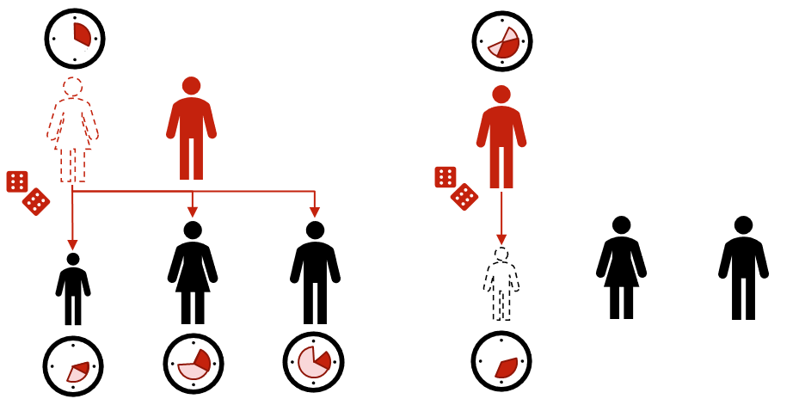
Modeling Infections
Each day, each location…
Receives a list of visits
Processes their arrivals and departures
Calculates the likelihood of infections

Slide 8
Modeling Infections
Each day, each location…
Receives a list of visits
Processes their arrivals and departures
Calculates the likelihood of infections
Infectious people have a chance of infecting each susceptible person at the location when they leave

Slide 9
Modeling Infections
Each day, each location…
Receives a list of visits
Processes their arrivals and departures
Calculates the likelihood of infections
Susceptible people have a change of being infected by each infectious person at the location when they leave

Slide 10
Disease Model
We represent diseases using finite state automata (FSA):
Each state represents a different stage in the progression of the disease
Each person maintains a disease state throughout the course of the simulation
This state determines whether or they can infect – or be infected by – other people
Every person starts in a susceptible state, moves to an exposed state after being infected, and progresses through subsequent states stochastically
Simulating a new disease is as simple as making a new FSA to represent it

Slide 11
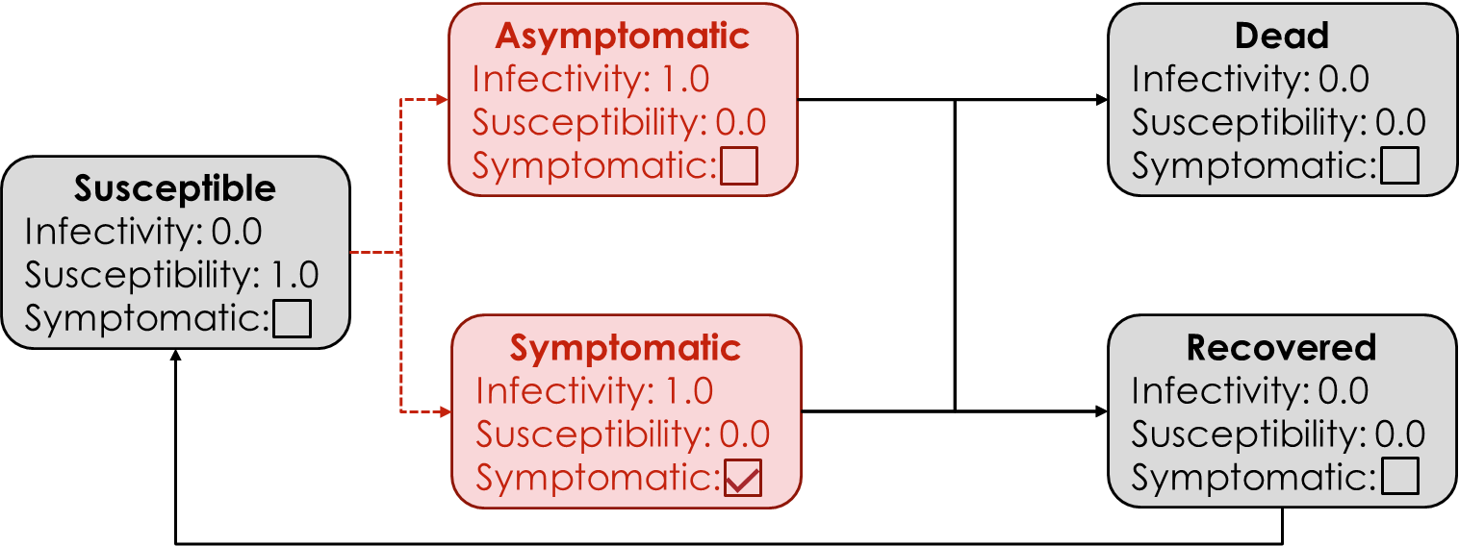
Disease Model
We represent diseases using finite state automata (FSA)
Each state represents a different stage in the disease

Slide 12
Disease Model
We represent diseases using finite state automata (FSA)
Each state represents a different stage in the disease
Every person starts in a susceptible state…

Slide 13
Disease Model
We represent diseases using finite state automata (FSA)
Each state represents a different stage in the disease
…and moves to an exposed state after being infected

Slide 14
Disease Model
We represent diseases using finite state automata (FSA)
Each state represents a different stage in the disease
Simulating a new disease is as simple as providing a new FSA

Slide 15
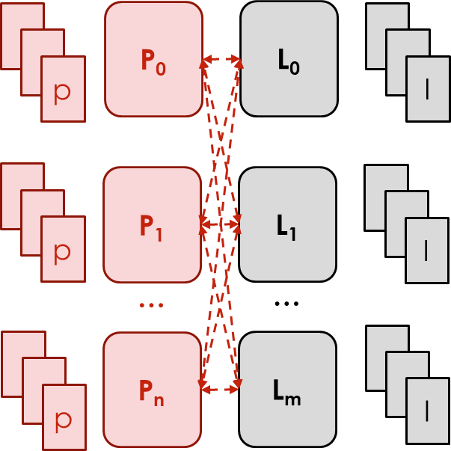
Implementation
We use…
Two chare arrays
One for people, one for locations
One nodegroup
For the disease model and other shared data

Slide 16
Implementation
People chares:
Send visit messages
Process interactions to determine if an infection occurs
Update disease states

Slide 17
Implementation
Location chares:
Process visits
Compute infection likelihood
Send interaction messages

Slide 18
Algorithm
0 for each day:
1 for each people chare pc:
2 for each person p:
3 pc.send(p.visits)
4 for each location chare lc:
5 for each location l:
6 visits = lc.receive(l)
intrs =
find_interactions(visits)
lc.send(intrs)
9 for each people chare pc:
10 for each person p:
11 if p.is_infected():
12 p.update_state()
13 else:
14 intrs = pc.receive(p)
15 infected =
processs(intrs)
16 p.update_state(infected)

Slide 19
Algorithm
0 for each day:
1 for each people chare pc:
2 for each person p:
3 pc.send(p.visits)
4 for each location chare lc:
5 for each location l:
6 visits = lc.receive(l)
intrs =
find_interactions(visits)
lc.send(intrs)
9 for each people chare pc:
10 for each person p:
11 if p.is_infected():
12 p.update_state()
13 else:
14 intrs = pc.receive(p)
15 infected =
processs(intrs)
16 p.update_state(infected)
p
p
l

Slide 20
Algorithm
0 for each day:
1 for each people chare pc:
2 for each person p:
3 pc.send(p.visits)
4 for each location chare lc:
5 for each location l:
6 visits = lc.receive(l)
intrs =
find_interactions(visits)
lc.send(intrs)
9 for each people chare pc:
10 for each person p:
11 if p.is_infected():
12 p.update_state()
13 else:
14 intrs = pc.receive(p)
15 infected =
processs(intrs)
16 p.update_state(infected)
p
p
l

Slide 21
Algorithm
0 for each day:
1 for each people chare pc:
2 for each person p:
3 pc.send(p.visits)
4 for each location chare lc:
5 for each location l:
6 visits = lc.receive(l)
intrs =
find_interactions(visits)
lc.send(intrs)
QD
9 for each people chare pc:
10 for each person p:
11 if p.is_infected():
12 p.update_state()
13 else:
14 intrs = pc.receive(p)
15 infected =
processs(intrs)
16 p.update_state(infected)
QD
QD

Slide 22
Algorithm
0 for each day:
1 for each people chare pc:
2 for each person p:
3 pc.send(p.visits)
4 for each location chare lc:
5 for each location l:
6 visits = lc.receive(l)
intrs =
find_interactions(visits)
lc.send(intrs)
9 for each people chare pc:
10 for each person p:
11 if p.is_infected():
12 p.update_state()
13 else:
14 intrs = pc.receive(p)
15 infected =
processs(intrs)
16 p.update_state(infected)
p
p
l

Slide 23
Experimental Design
We perform three experiments:
Two strong scaling studies, on Cori at NERSC and Theta at ALCF
An intervention case study on self-isolation, with varying levels of compliance
Systems used for experiments
Datasets used for experiments

Slide 24
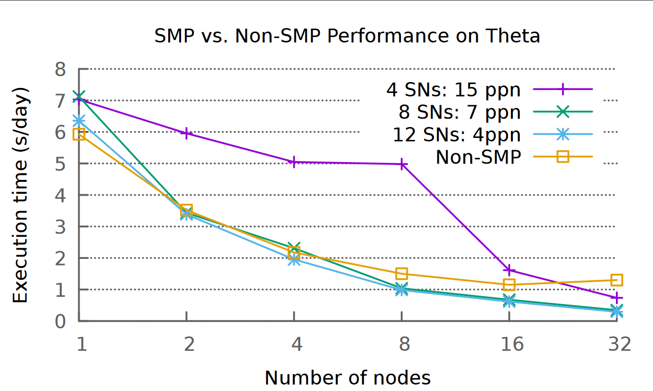
Tuning SMP
Before doing scaling runs we tested several SMP configurations

Slide 25
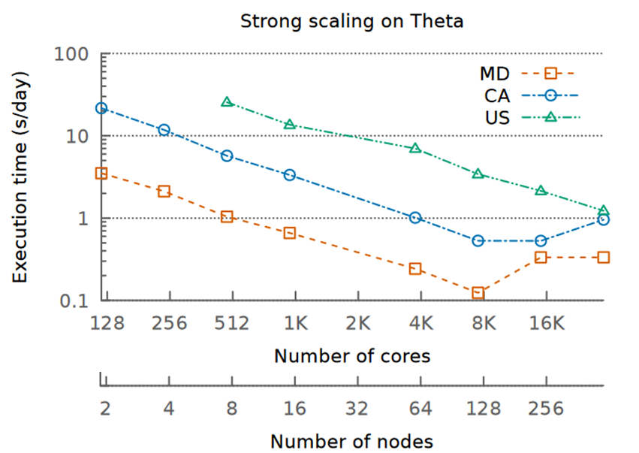
Results
On Theta:
Full-US dataset scales linearly up to 32K
California and Maryland datasets only scale linearly up to 8K
Speedup of ~40.81 on the CA dataset on 8k cores

Slide 26
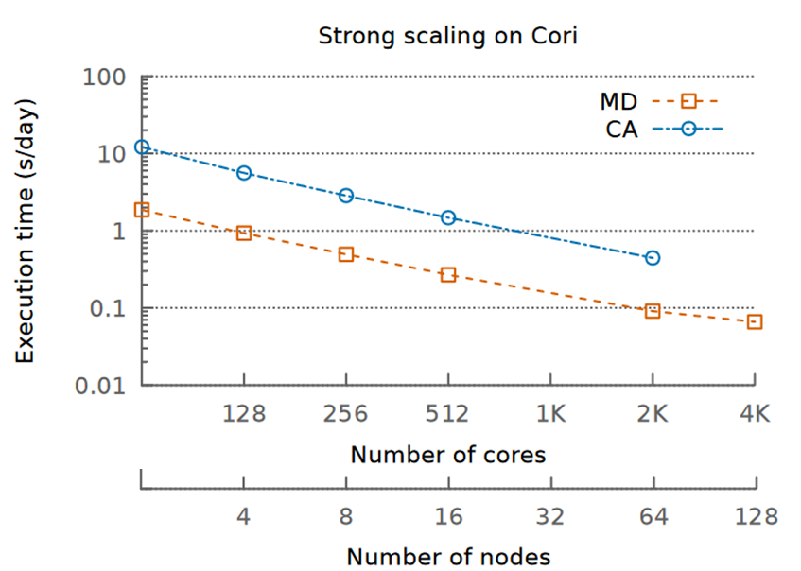
Results
On Cori:
Speedup of ~28 on the CA dataset on 4k cores

Slide 27
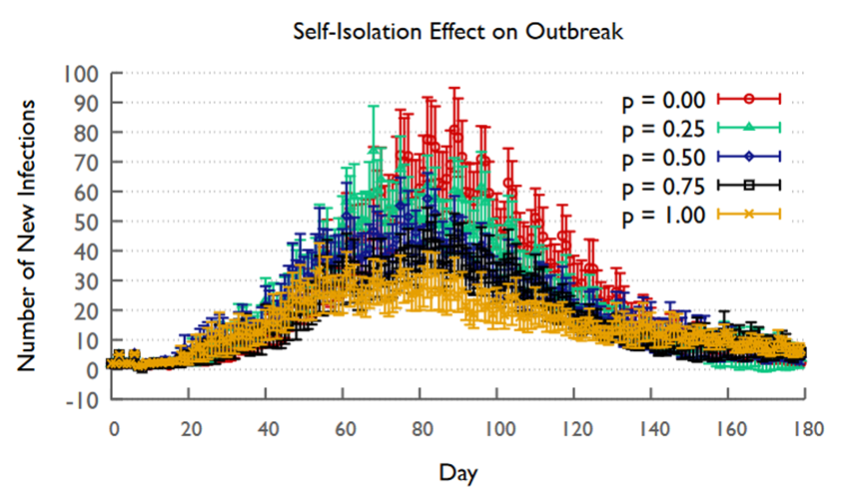
Results
Case Study:
Infections are reduced the more people follow the self-isolation intervention

Slide 28
Conclusions
We show that Loimos can:
Efficiently utilize resources on the NERSC Cori and ALCF Theta machines
Model the impact of interventions on a population of interest

Slide 29
Future Work
Reproduce scaling results using real state-level datasets
Combine real state-level population datasets into full-US dataset
Implement graph-based static load balancing
Investigate influence of social contact graph characteristics on performance

Slide 30
Future Work
Implement arbitrary intervention model
Validate simulation output against related application results
Compare simulation output with real-world case data

Slide 31
References
[1] Jones, K. E., Patel, N. G., Levy, M. A., Storeygard, A., Balk, D., Gittleman, J. L., & Daszak, P. (2008). Global trends in emerging infectious diseases. Nature, 451(7181), 990–993. https://doi.org/10.1038/nature06536

Slide 32
Joy Kitson
College Park, MD
jkitson@umd.edu

